Slide 1
Introduction to PIARC
November 2022

Slide 2
Why talk about roads?
Roads and Road transport are essential and they keep improving
  Roads represent about 80% of all inland transport, now and for the foreseeable future
  Roads are ready to support sustainable and low-carbon developments
  Roads are everywhere: active modes (cycling, walking), car sharing (Uber...), public transport (buses), alternative fuels (electricity, LNG or hydrogen…)
  Roads are key for equity, inclusivity and accessibility, and for UN's SDGs
Society's priorities and the larger context are evolving very quickly
That's why our work is ongoing, on a wide range of topics
  They are identified in order to serve the needs of our Members and of the road community
  Work is mainly conducted through our Technical Committees and Task Forces
  Their Members are officially appointed by PIARC Member Countries
  They write or improve reports based on best-practice and Identify directions

Slide 3
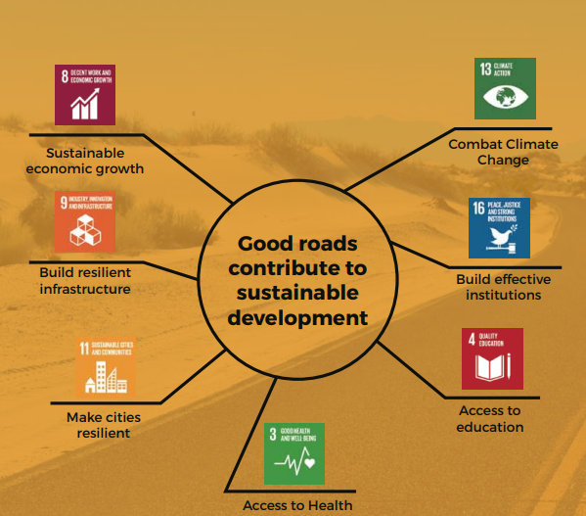
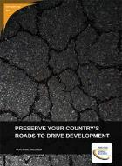
Roads serve the UN's Sustainable Development Goals
PIARC and DFID report, 2016

Slide 4
Introduction
What is PIARC?

Slide 5

What is PIARC?
PIARC = World Road Association
We were founded in 1909 as a non-profit, non-political association
First global forum for the exchange of knowledge, policy and practice on roads and road transport
Recognised for the quality and neutrality of our work
Work with HICs as well as with LMICs
We have 125 member governments, as well as regions, groups/companies and individuals.
The Association mobilizes the experience and knowledge of 1,200 experts from more than 80 countries in 20+ Technical Committees and Task Forces.
Notes:
PIARC is the new name for the WRA, PIARC stands for – Permanent International Association of Road Congresses.
PIARC was founded in 1909, -More than 110 years of existence
Our goal is to organise the exchange of knowledge, policy and practice on all matters related to roads and road transport
-Expert Committees, Reports, International Seminars…
It comprises of 125 member governments –
-High-income and lower-income countries on equal footing
-As well as private sector companies, universities, regions, individuals

Slide 6
PIARC’s Four key missions
Be a leading international forum for analysis and discussion of the full spectrum of transport issues related to roads and related transport;
Identify, develop, and disseminate best practice and give better access to international information;
Consider within its activities the needs of developing countries and countries in transition fully; and
Design, produce, and promote efficient tools for decision making on matters related to roads and related transport.
The Association mobilizes the expertise of its members
Through operations guided by a 4-year Strategic Plan

Slide 7
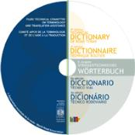
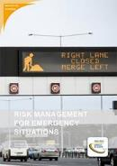

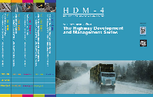
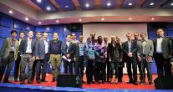

Knowledge exchange: The core of PIARC
PIARC mobilises international road and transport experts through more than 20 Committees:
  Ad-hoc dialogue among peers
  Network building
  Joint work towards commonly-agreed deliverables
These deliverables are widely accessible:
  Hundreds of Reports, Case studies, Literature reviews, etc.
  Seminars or workshops
  5 comprehensive manuals (online)
  Software and tools (HDM-4, QRAM)
  Usually in English, French and Spanish. Usually free of charge.
PIARC Congresses and events are world-class focus points for:
  Dissemination of these deliverables
  Further discussions and debate

Slide 8
PIARC and Languages
PIARC has three working languages:
  French, English and Spanish
  Our outputs are published in those 3 languages
The working language of TCs and TFs is English
TCs and TFs have to deliver their outputs in the 3 languages
  Organising translation is a task for the 3 Secretaries
  Support from GS, such as « DeepL Pro»
More translations are welcome
  Usually coordinated by National Committees

Slide 9
Our outputs

Slide 10
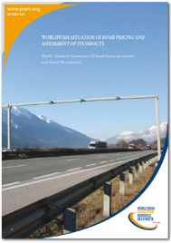
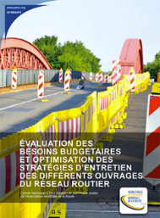
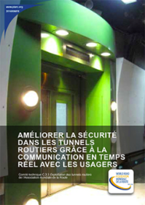
Many PIARC reports
Downloadable pdf files
Available for free at www.piarc.org
Cycle 2012-2015:
  40 technical reports were produced by the Technical Committees
Cycle 2016-2019:
  46 reports
Cycle 2020-2023:
  33 new reports already

Slide 11
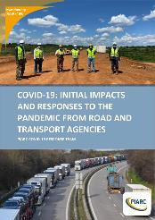
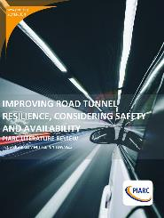

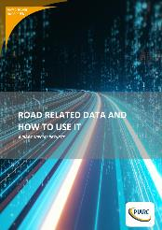
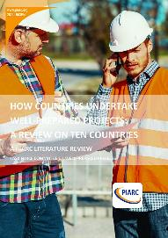
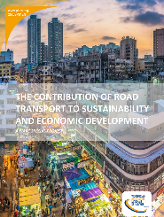
Recent PIARC publications (> 1 per month)
Improving Road Tunnel Resilience, Considering Safety and Availability - PIARC Literature Review
How Countries Undertake Well-Prepared Projects: A Review on Ten Countries
Snow and Ice Databook
Best Practices in Funding and Financing of Road Infrastructure
Diversity and Talent Management in Transport Administrations – The Road to Success?
Greening of Freight Transport
Use of Recycled Materials in Pavements
Many more coming in the next months
https://www.piarc.org/en/activities/PIARC-Directory-Technical-Reports/PIARC-Technical-Reports-2020-2023

Slide 12
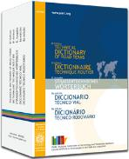
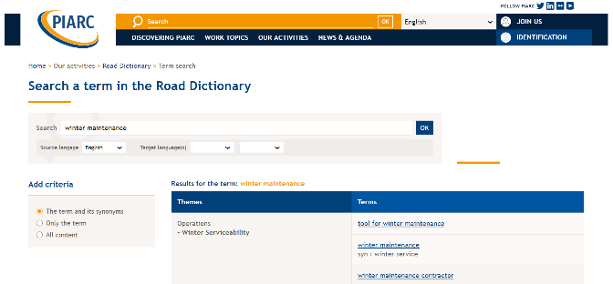
Online road dictionary
Technical Dictionary of Road Terms
Mainly: English, French, Spanish
Online, free of charge
As well as:
  Chinese 51%
  Estonian 41%
  Japanese 84%
  Dutch 100%
  Farsi 78%
  Polish 45%
And many other languages

Slide 13
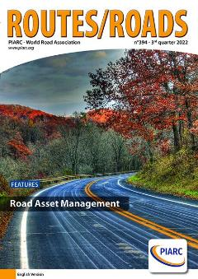
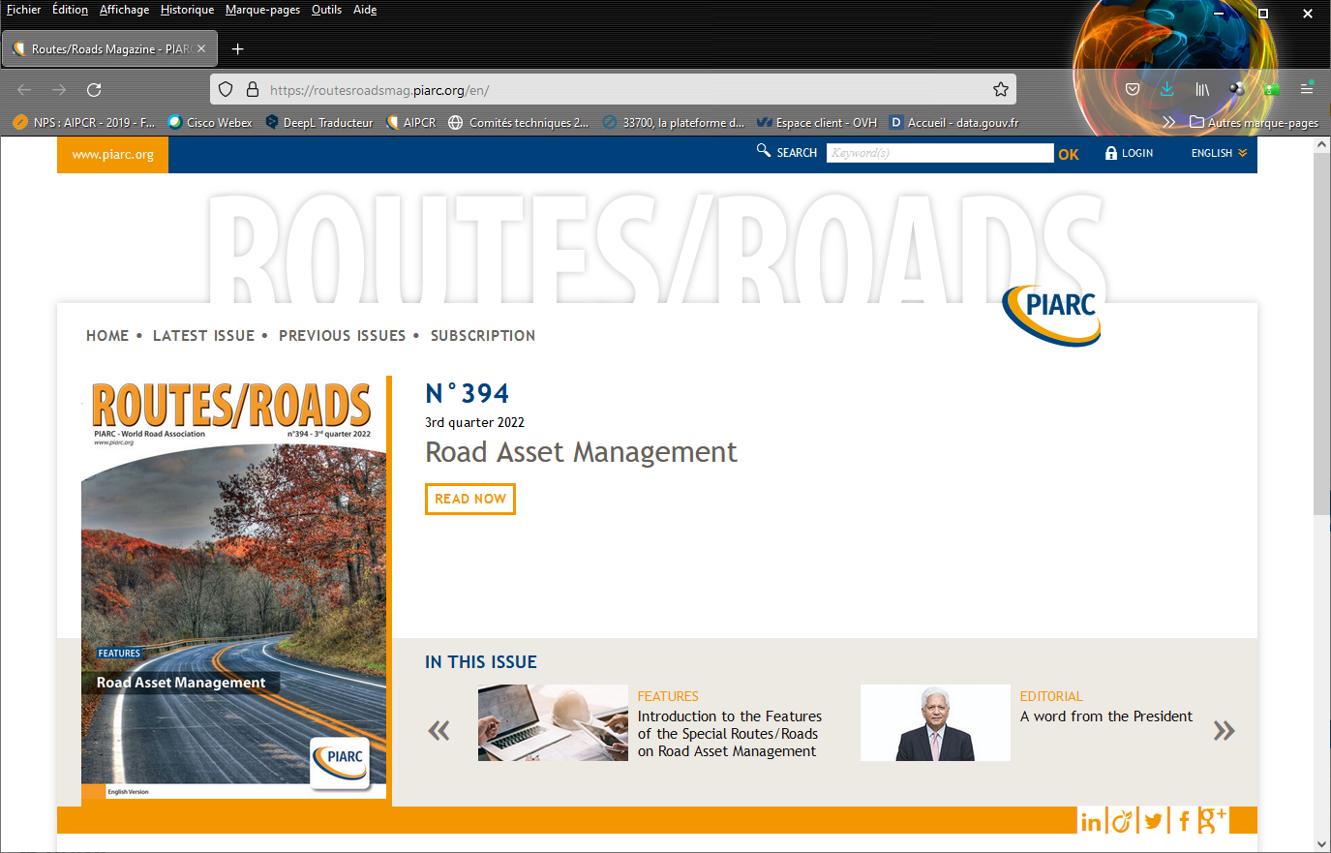
Routes / Roads Magazine
Our quarterly magazine
Articles cover emerging road and road transport issues
English, French and Spanish
Print and online distribution
5,700 copies, readership in more than 140 countries
Online versions:
  routesroadsmag.piarc.org
  https://www.piarc.org/en/activities/Routes-Roads-Magazine

Slide 14
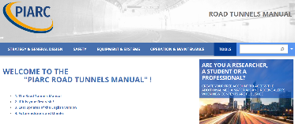
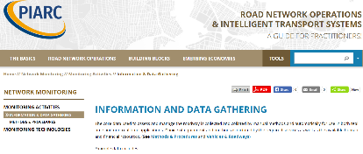
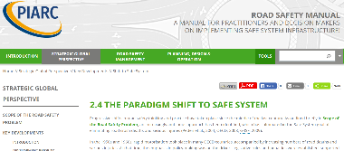
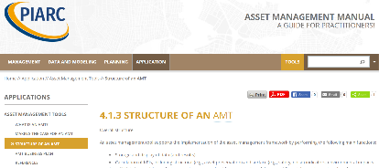
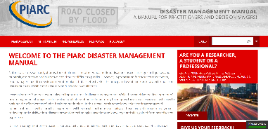
Online Manuals : Easy access to knowledge
Five online manuals:
  Disaster management (2022)
  Road Tunnels Operations (2019)
  Road safety (2019)
  Road asset management (2019)
  Road network operations and ITS (2015)
Easy and attractive to use:
  Free of charge
  Key principles for each of the topics are included and discussed in the sections
  Case studies and links to detailed technical material and other references
  Can be downloaded and printed in chapters

Slide 15
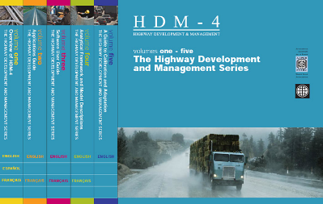
Software
HDM-4
  The primary tool for the analysis, planning, management and appraisal of road maintenance, improvements and investment decisions
  Developed with numerous stakeholders
  Distributed through HDMGlobal
DG-QRAM
  Tool for managing dangerous goods transport in tunnels
  Distributed by PIARC
  Version 4 is available (August 2019)

Slide 16


Many international PIARC Events
Many thematic seminars and workshops:
  October: "Implementation of BIM in Road Asset Management - Challenges and Opportunities", Mexico
  22-24 November 2022: "Climate change and disasters", Indonesia
  3 December 2022: "Development and management", Mexico
  14 Dec 2022: "Low and Lower-Middle Income Countries – Impact of ecology and climate transition on project preparation : financing, capacity building, technical standards", Online
  April 2023: "Advances in Design, Construction and Operation of Tunnels", India
  Etc.
  SURF 2022 - 9th Symposium on Pavement Characteristics
  Milan (Italy), 12-14 September 2022
  2nd PIARC International Conference on Road Tunnel Operations and Safety
  Granada (Spain), 25-28 October 2022
July 2021

Slide 17
Our structures

Slide 18
PIARC Organisational Structure
Council
Executive Committee
Strategic Planning Commission
Finance Commission
Member Countries & National Committees
- President
- Past President
- 3 Vice Presidents
22 members
Representatives of National Committees
Supports ExCom
Communication Commission
PIARC
General Secretariat
National Committees
Technical Committees
& Task Forces
Other
Road Administration
Safety and Sustainability
Mobility
Resilient Infrastructure
Terminology/Dictionary

Slide 19
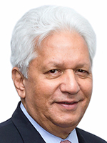
New Executive Committee 2022 - 2024
President
Past President
Vice-Presidents
Members
National Committees’ Representative
Nazir Alli, South Africa
Claude Van Rooten, Belgium
Emma Lía Albrieu Cipollina, Argentina
Geoff Allan, Australia
Mark Henry Rubarenzya, Uganda
Alexander Walcher, Austria, Anne-Séverine Poupeleer, Belgium, Bine Pengal, Slovenia, Birgitta Worringen, Germany, Joshua LaRocque, Canada, Chungeng Wu, China, Claudine Tremblay, Canada-Québec, Emanuela Stocchi, Italy, Emma Lía Albrieu Cipollina, Argentina, Ernesto Barrera, Chile, Geoff Allan, Australia, Hugh Gillies, United Kingdom, Hyeon-Seung Lee, South Korea, Juan Pedro Fernández Palomino, Spain, Jorge Arganis Díaz Leal, Mexico, Mamoudou Alassane Camara, Senegal, Mark Henry Rubarenzya, Uganda, Mārtiņš Dambergs, Latvia / BRA, Randall Cable, South Africa, Sandrine Chinzi, France, Sanjay Kumar Nirmal, India, Gloria Shepherd, USA, Setsuo Hirai, Japan, Václav Neuvirt, Czech Republic
Clemente Poon Hung, Mexico
<N°27>

Slide 20
48 PIARC National Committees in 49 Countries
They are independent country-based organisations.
Objectives:
  Facilitate national exchanges on roads and road transport
  Promote the work of PIARC
  Liaise with national experts and issues
  Algeria, Argentina, Australia (Austroads ), Austria,
  Belgium, Benin, Bulgaria, Burkina Faso,
  Cameroon, Canada, Canada-Québec, Chile, Colombia, Congo, Côte d’Ivoire, Czech Republic,
  Dominican Republic
  Ecuador
  France,
  Germany, Greece, Hungary,
  India, Ireland, Italy, Japan,
  Madagascar, Malaysia, Mali, Mexico, Mongolia, Morocco,
  Niger, New Zealand (Austroads ),
  Paraguay, Poland, Portugal, Romania,
  Senegal, Slovak Republic, Slovenia, South Korea, Spain, Switzerland,
  Tanzania, Tunisia
  United Kingdom, United States, Uruguay

Slide 21
General Secretariat
Main missions:
  Ensures the daily management of the Association in accordance with the resolutions and decisions of the Council and the Executive Committee.
  Represents the Association in all legal and administrative matters that impact on the operations of the Association.
Based in Paris
  Salaried staff as well as
  Experts seconded from their country

Slide 22
PIARC Committees and Task Forces

Slide 23
Membership
Members of PIARC Committees are formally appointed
Most are nominated by their First Delegate
  Member
  Corresponding Member (not compelled to take part in meetings)
Associate Members can be added:
  Initiative of TC/TF Chair or GS
  To be discussed with all TC/TF members
  Validation through General Secretariat

Slide 24
Work program
TCs / TFs are required to organize activities over the course of the four years (for TCs) and two years (for TFs):
  Allocating tasks to specific members of the TC/TF
  Identifying major milestones, Planning activities month by month
  Etc.
This work should adhere to the quality standards of PIARC:
  Aiming at a broad geographic representativity
  Implement a careful review process within the TC/TF
  Liaise with the STC and GS
Changes may occur, New ideas may emerge, Difficulties may occur…
  That’s normal
  Need to be identified by the Chair and discussed with STC and GS

Slide 25
PIARC Congresses

Slide 26
Congresses in 2020 - 2023
The World Road Congress
  Important event that has established the Association’s reputation and is held at the end of a four-year work cycle
  The next WRC will take place in Prague in 2023
World Winter Service and Road Resilience Congress
  Held roughly halfway through the four-year cycle
  Similar objectives and outcomes as the World Road Congress albeit with more focussed topics
  The last edition was Calgary in February 2022 (online)
  It tackled resilience in addition to winter issues
  https://proceedings-calgary2022.piarc.org
The programme of both Congresses is coordinated by PIARC.
A call for papers is organised for both Congresses.

Slide 27
World Road Congress 2019 - Abu Dhabi
6 – 10 October 2019
Full proceedings are available here:
https://proceedings-abudhabi2019.piarc.org

Slide 28
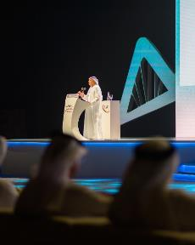



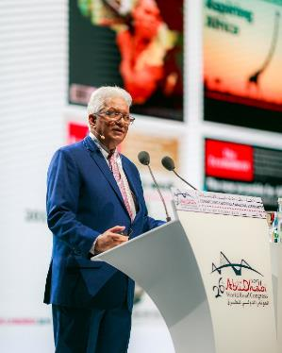
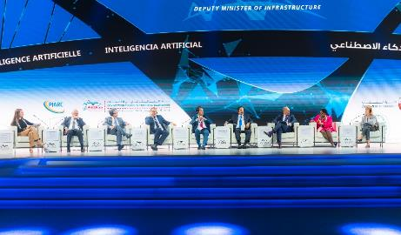

Slide 29
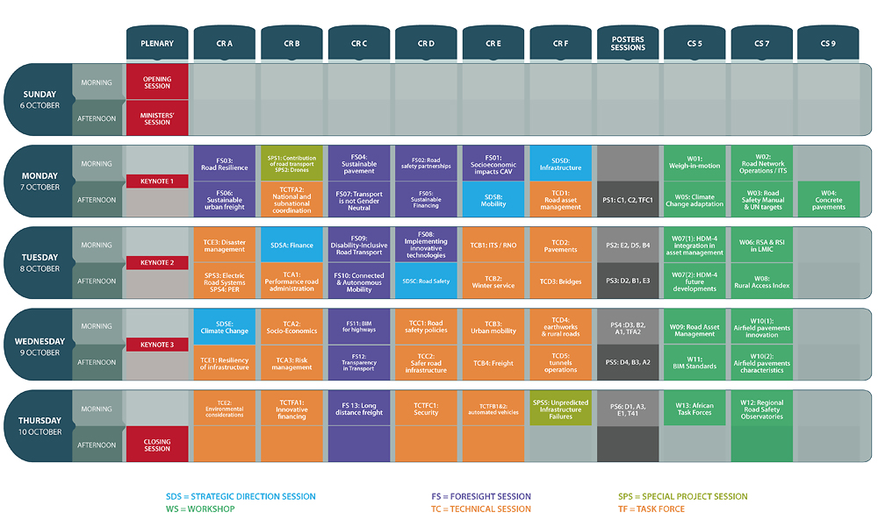

Slide 30

27th World Road Congress
2 – 6 October 2023
Very rich technical Content:
  Ministerial session
  All our 25 Committees will present their work
  Papers from the call for papers on 49 topics will be presented too (we received 766 abstracts)
  Foresight Sessions with our partner organisations
Great opportunity to:
  Present your work with a national pavilion
  Engage with ministries, with experts, with industry…
  Learn more about PIARC outputs
  Discuss new ideas
https://www.piarc.org/en/activities/World-Road-Congresses-World-Road-Association/XXVII-World-Road-Congress-Prague-2023

Slide 31

Next PIARC Congresses
17th World Winter Service Congress
  Chambéry, France
  February 2026
28th World Road Congress
  Call for candidacies will be published in January 2023

Slide 32
PIARC Strategic Plan 2020 - 2023

Slide 33
Role of the Strategic Plan
The Strategic Plan guides the activities of PIARC over a 4-year cycle.
In particular, it:
  Identifies what are the priority issues for PIARC members
  Establishes Committees and Task Forces

Slide 34
Development of the Strategic Plan
The process involved several steps of consultation:
Internally: First Delegates, National Committees and Technical bodies, Low and Middle income countries.
Externally: Advisory group – Workshop, Interviews with external stakeholders.
New STCs, Chairs and Secretaries were consulted too
The next Plan, covering 2024-2027, is under development
  Focus on resilience, road safety, digitalization, decarbonization

Slide 35
Goals
Increase flexibility to attend PIARC members’ needs in a quick changing world.
Produce more useful and frequent outcomes to give more visibility to PIARC, and to make it more relevant.
Improve quality of outcomes, so that PIARC continues to be recognized for producing valuable road related products.
Ensure a diversified and value-added production of outcomes to improve PIARC’s portfolio and extend its scope to a wider audience.
Overcome the “silo concept” among Technical Bodies to achieve a more integral and interconnected knowledge, and to add cross-cutting issues.

Slide 36
Key horizontal issues
Climate change
Resilience
Road safety
Our Plan reflects mega-trends, including those that go beyond roads
It also places roads in the context of the global transport system

Slide 37
PIARC Technical Committees 2020 – 2023
1. Road Administration | 2. Mobility | 3. Safety and Sustainability | 4. Resilient Infrastructure
TC 1.1 Performance of Transport Administrations | TC 2.1 Mobility in Urban Areas | TC 3.1 Road Safety | TC 4.1 Pavements
TC 1.2 Planning Road Infrastructure and Transport to Economic and Social Development | TC 2.2 Accessibility and Mobility in Rural Areas | TC 3.2 Winter Service | TC 4.2 Bridges
TC 1.3 Finance and Procurement | TC 2.3 Freight | TC 3.3 Asset Management | TC 4.3 Earthworks
TC 1.4 Climate change and resilience of Road Network | TC 2.4 Road Network Operation/ITS | TC 3.4 Environmental Sustainability in Road Infrastructure and Transport | TC 4.4 Tunnels
TC 1.5 Disaster management
TF 1.1 Well-Prepared Projects | TF 2.1 New mobility and its impact on road infrastructure and Transport | TF 3.1 Road Infrastructure and Transport Security | TF 4.1 Road Design Standards
(TF 1.2 HDM-4) | TF 2.2 Electric Road Systems
TF 1.3 Well-Prepared Projects in LMICs
Terminology Committee
Road Statistics Committee

Slide 38
Some organisation directions

Slide 39
PIARC and LMICs
PIARC covers High Income Countries as well as Low and Middle-Income Countries
We take care to include LMIC-specific topics in the work of our Committees
HICs as well as LMICs are represented on our decision-making bodies
Support mechanisms are available:
  Special fund to cover part of the travel expenses of experts to PIARC events
  Funding for PIARC seminars in LMICs

Slide 40
PIARC Partnerships
Objectives:
  Avoid duplication
  Share opinions
  Contribute to one another’s activities (e.g. Strategic Plan)
  Promote our outputs
Examples:
  ITF
  World Bank
  Regional road organisations
  Etc.
Advisory Group

Slide 41
Gender inclusion and Diversity
Gender inclusion and diversity were recently agreed as values for PIARC
Practical actions will include:
Encourage women's participation in PIARC activities
Cover gender-specific needs in the work of our Committees
Organise ad-hoc training and mentoring sessions

Slide 42
Conclusion

Slide 43
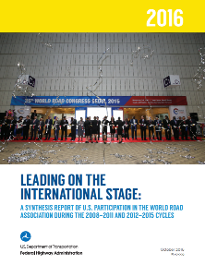
World Wide Knowledge exchange:
The core of PIARC
Aimed at practitioners more than research
International dialogue is more necessary than ever
  Efficient and Cost effective
  Cf. FHWA report « Leading on the international stage » (2016)
PIARC mobilises international road and transport experts:
  We provide the network
  Ad-hoc dialogue among peers
  Showcasing national achievements
Our outputs are open to all and widely accessible:
  Reports, Online tools, Workshops, Seminars, Congresses…
  Learning from others
  Building networks
  Joint work towards commonly-agreed deliverables

Slide 44
Advantages of being a member
Easy access to existing reports and to a wide network of colleagues
In Committees, the country's experts can discuss with their peers
  Learn from them, Share national examples (promotion)
  Develop common solutions or approaches to issues
  Quick access to experts if you have an urgent problem (and it's free)
  These exchanges are efficient : save time and money
Mobilize the national road community
Take part in the strategy and management of PIARC
International recognition and Influence
Exhibit at the World Road Congresses

Slide 45
Thank you for your attention!
Nazir Alli
PIARC President

Slide 46
Acronyms
TC: Technical Committee
  Sometimes also used for the Terminology Committee and the Road Statistics Committee
TF: Task Force
STC: Strategic Theme Coordinator
  Oversees a Theme, i.e. a collection of TCs and TFs
SPC: Strategic Planning Commission
  Monitors the implementation of the Strategic Plan
ExCom: Executive Committee
1D: First Delegate
  Main representative of a member country (e.g. Road Director)
GS: General Secretariat

